Slide 1
Parallelizing a Face recognition Attendance system
CMIS 4153 – Parallel Computing
182164 – B R Madurangi
182160 – I A S Kaumadi

Slide 2
Introduction
This is an attendance system using face recognition
This system detects the given image by searching for the similar images using OpenCV
In order to develop the system, we have used Python as the programming language and Visual Studio Code as the IDE
By using multiprocessing, we have then parallelized the program to run on several processors simultaneously

Slide 3
Problem
Existing face recognition attendance systems can be slow and inefficient, particularly in large organizations.
These systems require high processing power and memory usage, and they lack scalability, making them unsuitable for handling large volumes of data.
The accuracy of these systems may suffer when processing large amounts of data due to increased processing time and memory usage.

Slide 4
Proposed Solution
The proposal is to parallelize the face recognition attendance system using Multiprocessing.
Distributing the processing workload across multiple cores can significantly reduce the processing time and memory usage required for the system.
Parallelization can improve the scalability and accuracy of the system, making it more suitable for use in large organizations.

Slide 5
Methodology
Implement the face recognition system in Python using the OpenCV and pip libraries.
Introduce multiprocessing to the system by dividing the workload into multiple processes that can be executed in parallel.
Choose an appropriate multiprocessing method, such as the multiprocessing module and implement it in the system.
Evaluate the performance of the parallelized, such as processing time,
Consider future extensions and improvements to the system such as adding camera to take Realtime pictures.

Slide 6
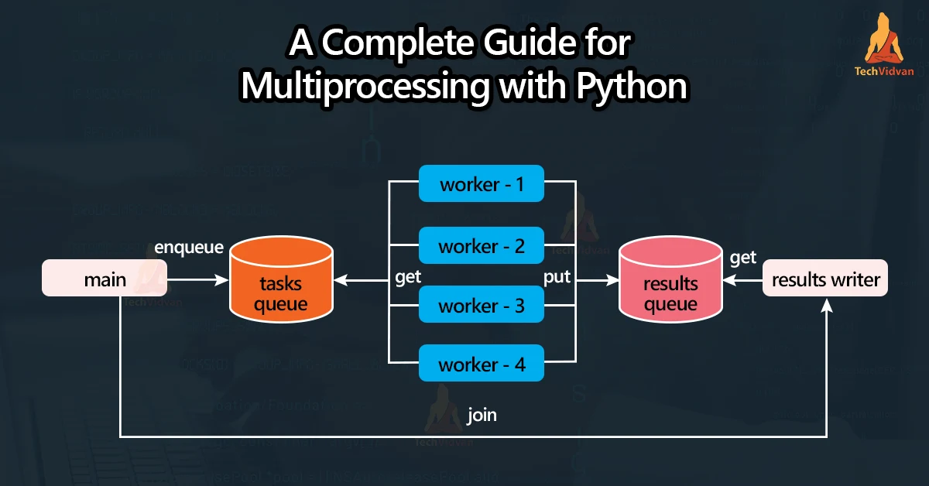
Multiprocessing
Multiprocessing utilizes multiple processors or cores in a system to perform tasks simultaneously, improving performance and reducing processing time.
Python's multiprocessing module manages subprocesses with features such as inter-process communication and shared memory management. It's useful for CPU-bound tasks such as data processing, machine learning, scientific computing, and image processing, dividing workloads into independent tasks executed concurrently on different CPU cores.

Slide 7
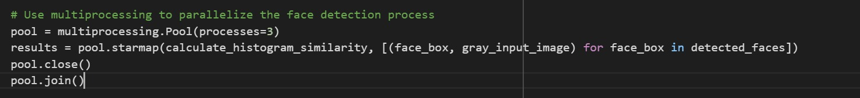
Implementation
Import the required libraries for multiprocessing and face recognition.
Define the number of processes to use based on the number of CPU cores available.
Using Multiprocessing pool library, Load the dataset and split it into smaller chunks for parallel processing.
Combine the results from each process and output the final attendance report.

Slide 8
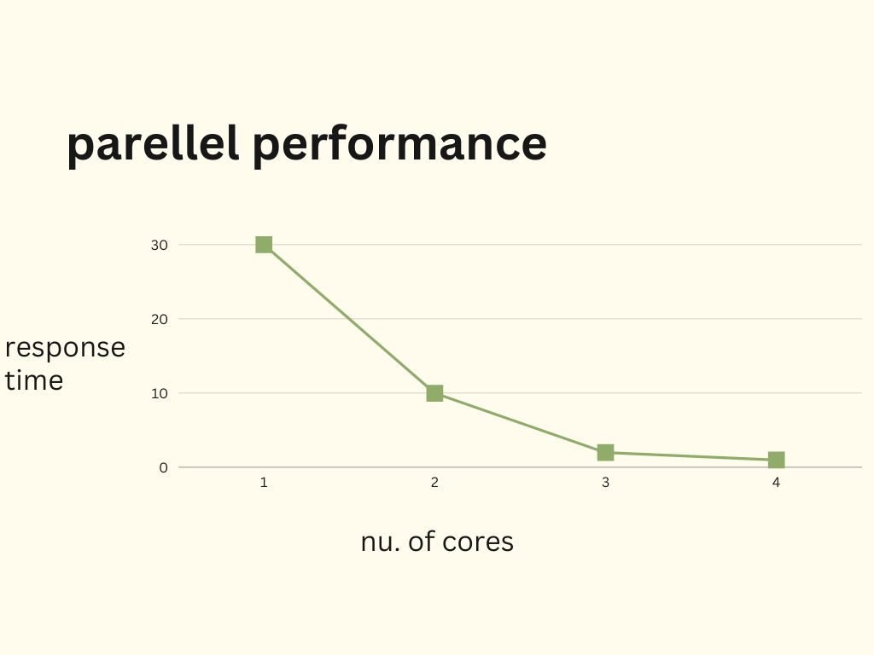
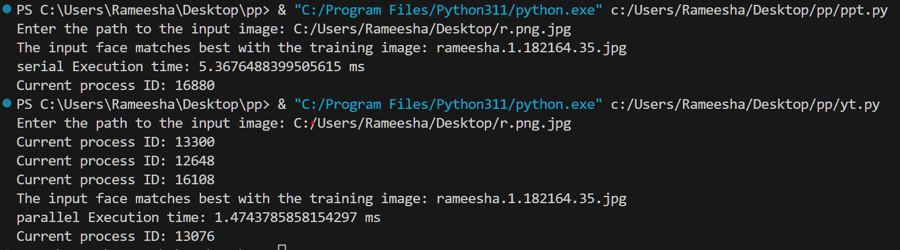
Results

Slide 9
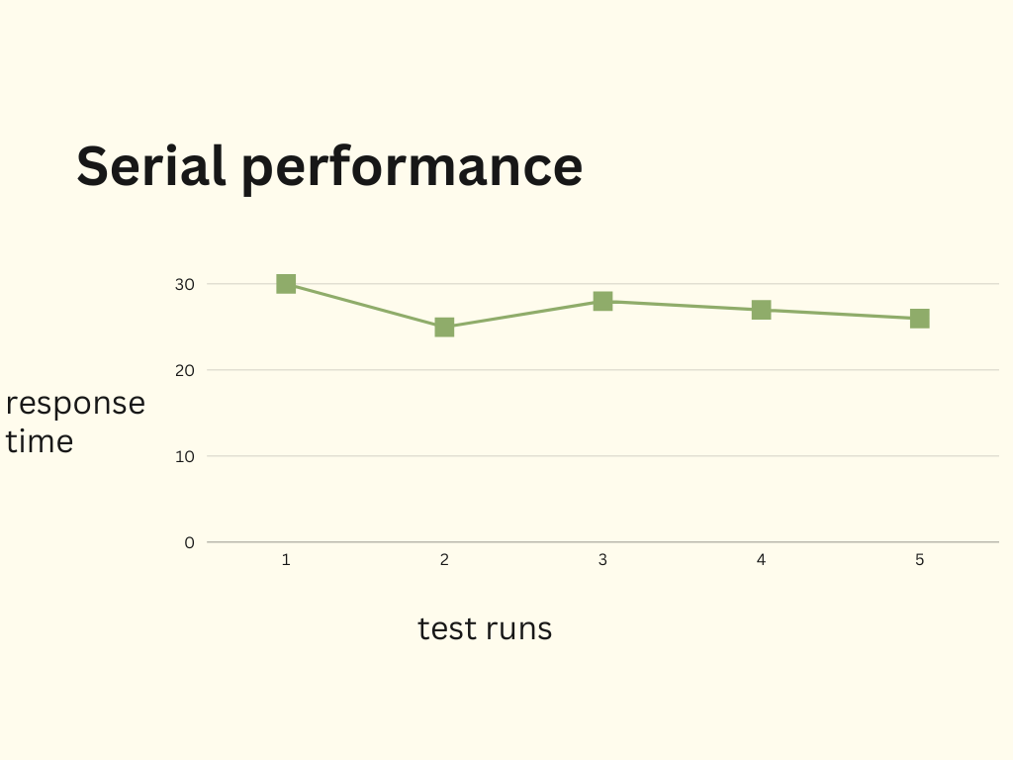
Evaluation

Slide 10
Demonstration

Slide 11
Discussion
Parallelizing a Python face recognition system using multiprocessing Improved performance and reduced processing time by dividing workload into multiple parts and executing them simultaneously across multiple CPU cores
Multiprocessing allows developers to create and manage multiple subprocesses within a Python program
The module includes features for inter-process communication, shared memory management, and synchronization
Particularly useful for CPU-bound tasks such as data processing, machine learning, scientific computing, and image processing

Slide 12
Questions & answers

Slide 13
References
[1]. https://github.com/shubhamkumar27/Face_recognition_based_attendance_system
[2]. https://www.youtube.com/watch?v=rVQv1TwvQBc&t=358s
[3].
https://www.geeksforgeeks.org/parallel-processing-in-python/

Slide 14
THANK YOU!

